Slide 1
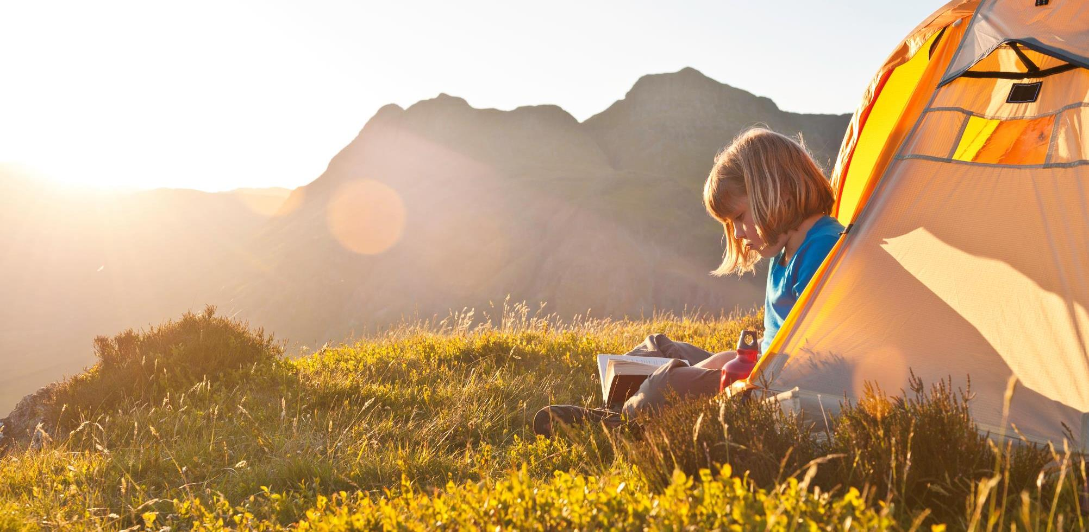
Sun and Sights
Tired Eyes and Sore Fingers: Project 1
Notes:
Hello, we are Tired Eyes and Sore Fingers, and this is our application, “Sun and Sights”
1
01/03/2021

Slide 2
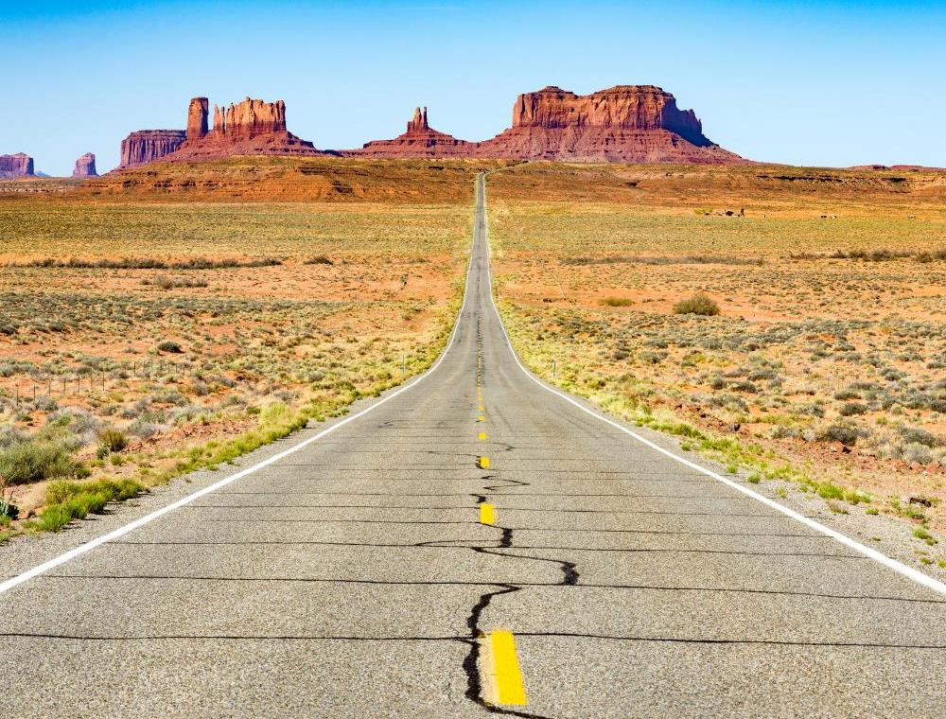
Contents
2/1/20XX
2
Topic: Elevator Pitch/Introduction
Topic two: Planning & Deliberation
Topic three: Application & User Story
Topic four: Roles & Challenges
Topic five: Demonstration & Questions
Sample Footer Text
Notes:
To start with today we will deliver our elevator pitch for the application. We’ll then introduce you to the general idea surrounding our application and how we reached this idea. Following this we’ll talk a little about the team behind it and everybody’s role in the process, giving credit where it is due. We’ll then delve deeper into the challenges we faced during this project and successes derived from these. Finally, we will give you a demonstration of the application and take any questions.
2
01/03/2021

Slide 3
Pitch
2/1/20XX
‹#›
Ever gone travelling and found yourself navigating a million opened tabs rather than the country you’d set out to explore?
Sample Footer Text

Slide 4
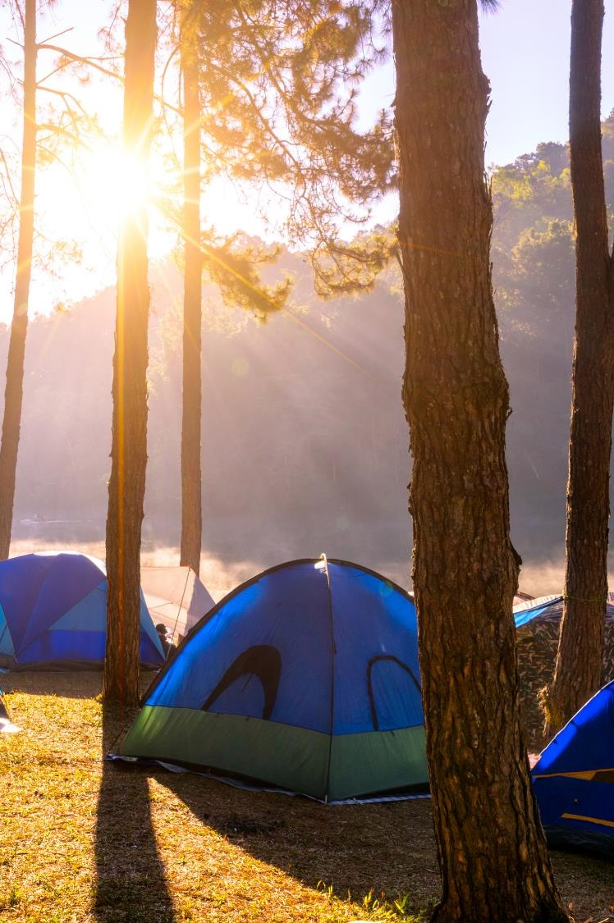
Introduction
3
We are Group 19, named Tired Eyes and Sore Fingers. We started Sun and Sights, an application that illustrates details (a 5 day weather forecast, map of attractions) of a searched location, with three members hoping to be four. We ended as a group of two, you can decide which of us is tired eyes and who is sore fingers.
Sample Footer Text
Notes:
We are Tired Eyes and Sore Fingers, group Number 19, a name that become more apt as the project progressed. We started Sun and Sights, an application that illustrates details (a 5 day weather forecast, map of attractions) of a searched location, with three members hoping to be four. We ended, through no fault of our team leader who contributed so much in the first half of the project and laid the basis of what was to come, as a group of two. You can decide who is tired eyes and who is sore fingers.
3
01/03/2021

Slide 5
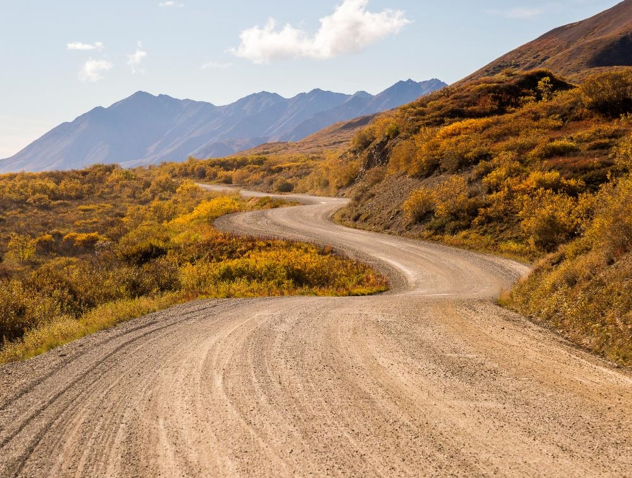
Sun and Sights
2/1/20XX
4
Multi-Destination Travel Application
Notes:
Our application, Sun and Sights, is built with the multi-destination traveler in mind. Our original concept, the brainchild of Oliver/Me, centered around giving hikers an accurate impression of the terrain they were about to endure on their journeys into the wilderness. I/Oliver found that, before embarking on multi-day treks in Northern Finland, checking the weather for the destination was best complimented by checking recent geotagged photographs from that area. This would give an impression of not just the weather in the sky but on the ground, as well as how populated the trail, and hiking shelters provided, would be. Alas, Meta, the company with a monopoly of all recent geotagged photographs, included a lot of bureaucracy around gaining access to this feed of information, including the creation of a government recognized business, and as such we were forced to abandon the idea for this project.
Thankfully, whilst I squandered time reaching dead ends, our team leader Zuhra devised a similar application, but with a more general concept of traveler in mind. The Openweather API used in the original application was still to be utilized, just instead in conjunction with a much more accessible API that could illustrate the top tourist attractions in a given area. We changed the name from UnConditional to Sun and Sights and the targeted user from the wilderness hiker to a more general, multi-destination tourist. The user would be able to add a plethora of possible destinations at the start of their journey then flick through them as they progressed, assessing the weather against what sort of attractions were on offer.
4
01/03/2021

Slide 6
User Story
2/1/20XX
‹#›
As a tourist, I want to have easy access to the weather and attractions so that I can make informed decisions about where to head next
Sample Footer Text
Notes:
We condensed all of this down to a user story, which is as follows.
01/03/2021
‹#›

Slide 7
Technologies Used
2/1/20XX
‹#›
Openweather API
Google Maps API
Local storage accessed
HTML features were bootstrapped
Sample Footer Text
Notes:
The two APIs we used were the Openweather API and the Google Maps API. These two APIs accessed local storage in order to provide easy access to previously searched locations. Other HTML elements of the project, such as the nav bar, were bootstrapped.
01/03/2021
‹#›

Slide 8

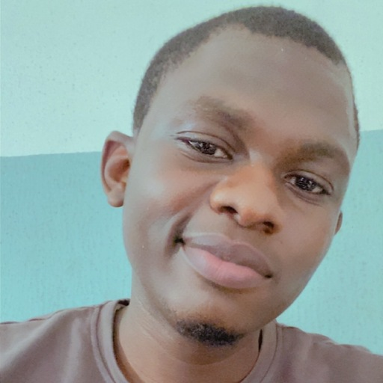
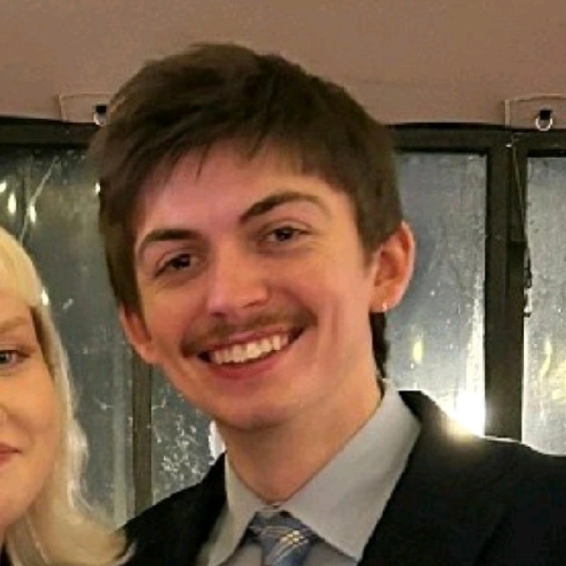
Team
2/1/20XX
5
Zuhra
Yusuf
Yusuf
Usman
Oliver
Stamper
Mahat
Ahmed
Sample Footer Text
Notes:
Although on paper we are a team of four, Sun and Sights at our strongest only ever had three real team members, dropping down to two justifiably later in the process.
From the very start, Zuhra took charge in this project, contributed massively during the preliminary stages of the process, and so struck us as a natural team leader, leading Yusuf to propose this role to her and me to endorse it. It proved to be a wise decision as we traversed the initial hurdles of the project, when our first idea seemed unviable, she maintained positivity and delegated us to explore other ideas while she devised the workflow we were set to follow throughout the rest of the project through Trello. She can be credited with the idea we eventually pursued, something she conjured outside of class hours, and Yusuf and I sought to implement this idea to a standard she will be satisfied with when, due to tragic personal circumstances, it was left to us to finish.
The use of Trello to record the workflow became an unnecessary encumbrance once the team dropped to two members, as a 50:50 division of work was not hard to comprehend or implement and as such we soon abandoned the recording of the operation as we had enough on our plates. Thankfully the wireframe I drew up using Figma was still applicable to the new idea with just a few minor changes. Given my recent success in the Weather API challenge, I set to work on installing an identical application to our webpage. Once this was complete, Yusuf used his past experience surrounding the Maps API to ensure this was also present on the application.
Once both API’s were present I attempted, unsuccessfully, to link them both to the same search bar I had earlier inserted. Thankfully Yusuf achieved this. After this there were a few patches to complete like getting rid of attractions from past searches and updating the data from past searches. While Yusuf handled this, I took care of this presentation. Towards the end I worked on adding our information to the footer along with a link to our github pages, to encourage further collaboration on the project.
01/03/2021
‹#›

Slide 9
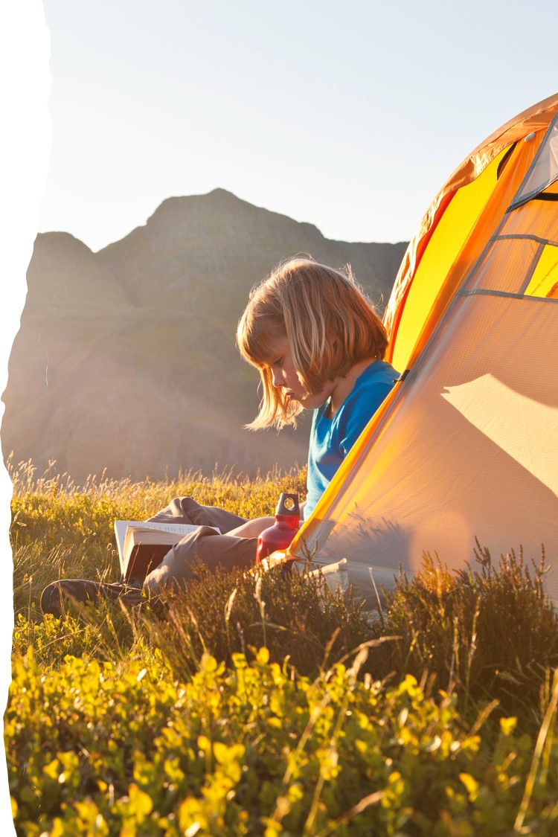
Challenges
2/1/20XX
7
Utilising the Meta API.
Making both APIs run from the same search bar.
Clearing the attraction information from the most recently searched city.
Making the application functional from the saved searches.
Sample Footer Text
Notes:
Aside from the absence related workload challenges, one of the most time-consuming issues we faced was trying to get the Meta API working. We were all very enthusiastic about the original project idea, so we were reluctant to abandon our attempts at this, however our team manager Zuhra convinced us that this was our only course of action.
Difficulties encountered bringing the current application to completion included making them both run from the same search bar, clearing attraction information from the most recently searched city as well as making the application functional off past saved searches.
7
01/03/2021

Slide 10

Demo
2/1/20XX
6
Sample Footer Text
Notes:
6
01/03/2021

Slide 11
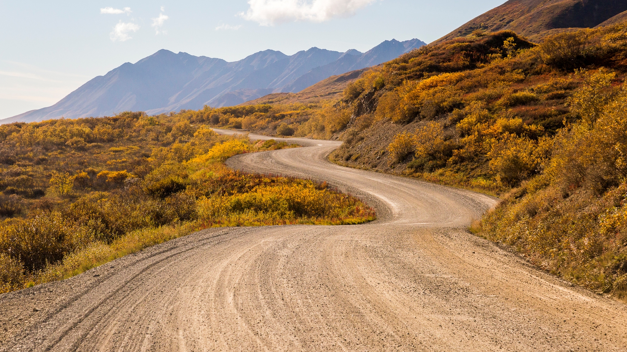
Directions for future development
2/1/20XX
8
Notes:
The app in it’s current form, though highly functional and useful to our market, is pretty basic and could incorporate other features to be developed in a number of ways. One such improvement could be more customisable search parameters, allowing users to enter the proposed accommodation for the stay and showing attractions nearby the location. This could be useful in large cities such as Tokyo. A different finetuning feature would be for the application to highlight attractions that are suited to the current weather, giving the user even less legwork, however this could cause frustration for users who are happy to visit attractions like parks in the rain.
8
01/03/2021

Slide 12
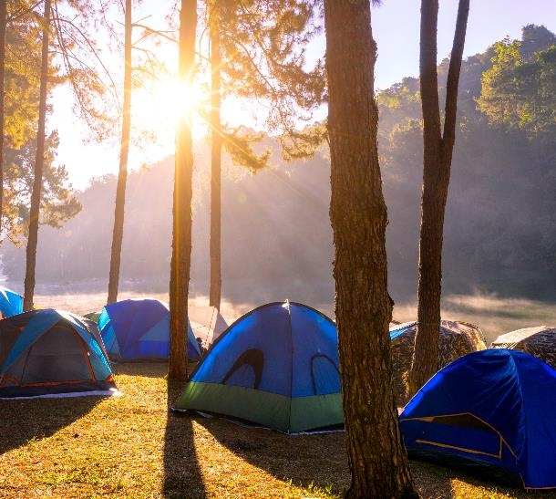
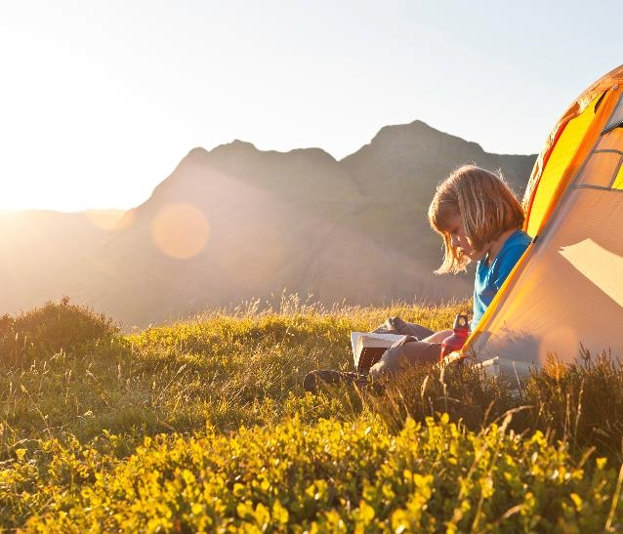
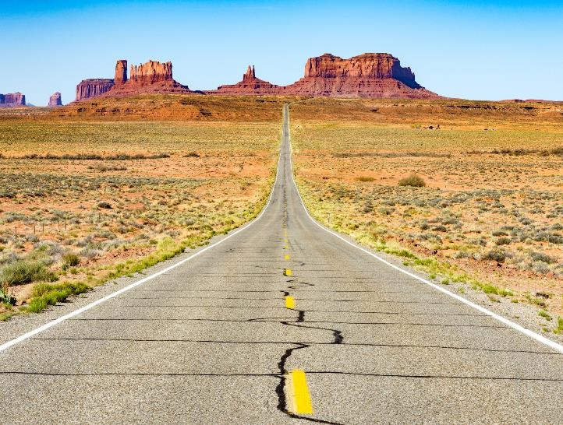
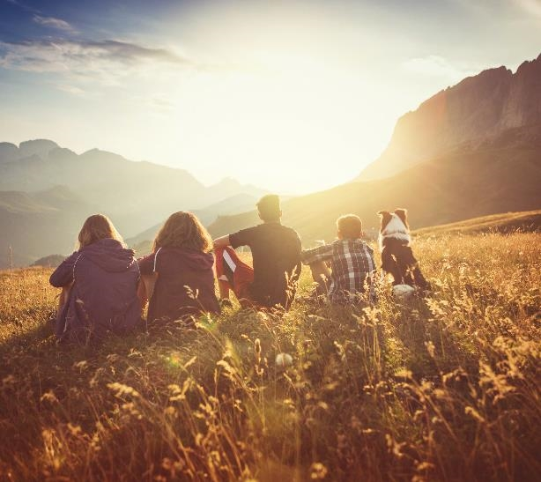
Thank you
2/1/20XX
13
Sample Footer Text
Notes:
Thank you so much for listening to us today, we’ll be happy to take any questions now.
13
01/03/2021

